Slide 1


Machine Learning in Medicine Sequence Generation with ONLY Numpy
Keywords : Sequence Models, Sequence Generation, Deep Learning, RNN, Numpy
SungKyunKwan Univ.
Samsung Advanced Institute for
Health Sciences & Technology
Department of Digital Health
Mincheol Kim
BMI Lab.

Slide 2
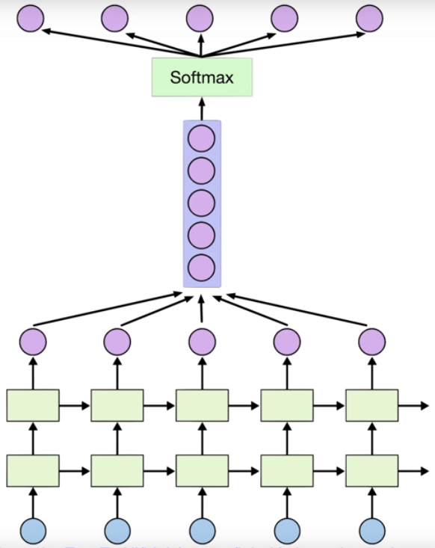
Overview
https://github.com/mnchl-kim/seq2seq-Numpy
seq2seq - Numpy
< Sequence to Sequence >
Training
Generation
Time-Series
Data
Time-Series
Sequence
Language Generation
Signal Generation
…
https://jfun.tistory.com/192?category=845567

Slide 3
Source Code
https://github.com/mnchl-kim/seq2seq-Numpy
seq2seq - Numpy
- GitHub URL
https://github.com/mnchl-kim/seq2seq-Numpy
https://github.com/DHC5036/2019-fall-project-mnchl-kim
utils.py : Includes several necessary function for running the other source code
model.py : class RNN (stacked Recurrent Neural Networks) with ONLY Numpy
train.py : Train data with RNN class
test.py : Test file for live demo
To test the stacked RNN model, I used text data in online.
character-level language generation.

Slide 4
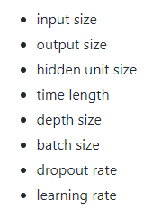
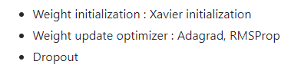
model.py
https://github.com/mnchl-kim/seq2seq-Numpy
seq2seq - Numpy
class RNN:
Stacked Recurrent Neural Networks with ONLY Numpy
The following parameters can be selected in the RNN class. Additional information for RNN class
class LSTM:
- ing...
- You can find out the source code at ‘./models/lstm.py’

Slide 5
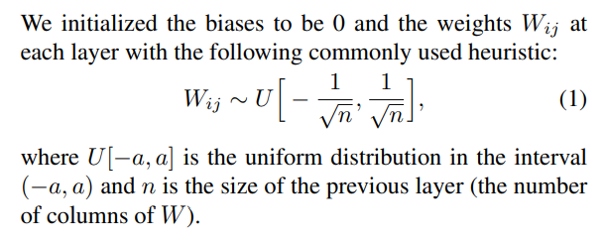
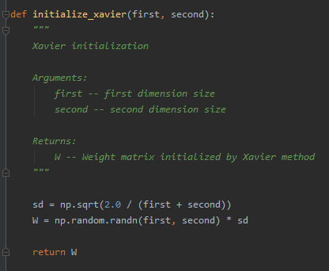
model.py
https://github.com/mnchl-kim/seq2seq-Numpy
seq2seq - Numpy
Weight initialization
: Xavier initialization

Slide 6
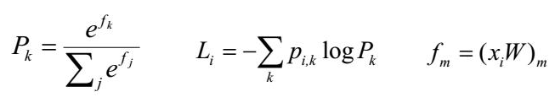
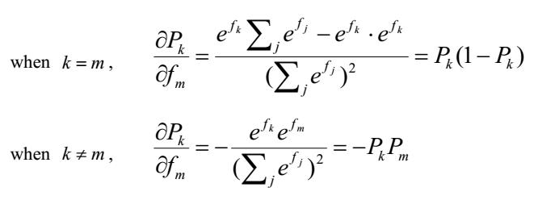
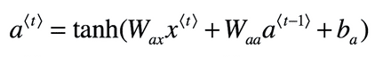
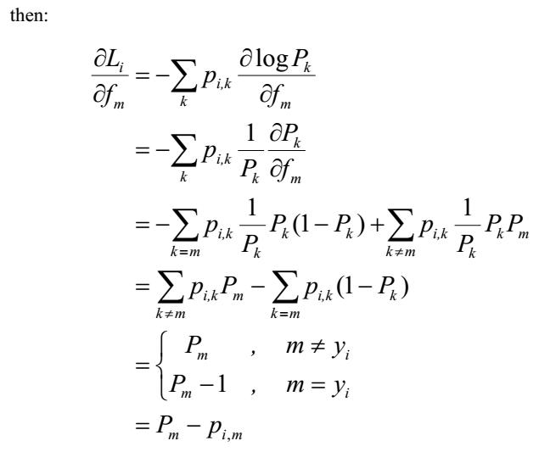
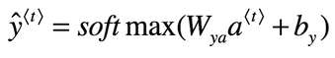
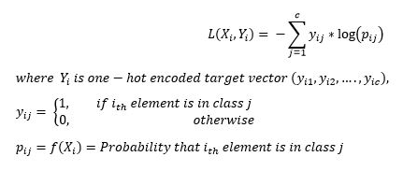
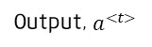
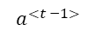
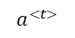
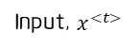
model.py
https://github.com/mnchl-kim/seq2seq-Numpy
seq2seq - Numpy
Stacked Recurrent Neural Networks
Output, $a^{<t>}$
< Backward Propagation >
ⅰ) Derivative of Cross Entropy Loss, Softmax
Prev
Hidden State
Next
Hidden State
$$a^{<t −1>}$$
$$a^{<t>}$$
Input, $x^{<t>}$
< t > cell
< Forward Propagation >
At last layer,
Multi-class Cross Entropy Loss

Slide 7
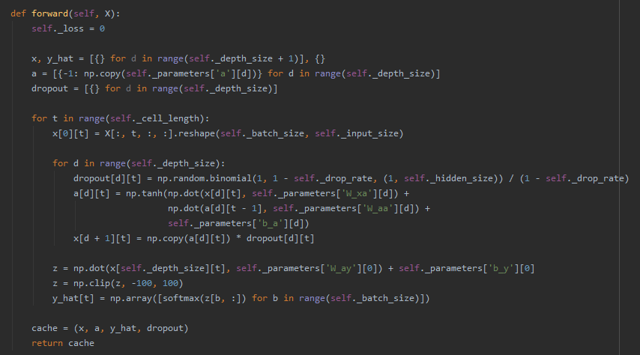
model.py
https://github.com/mnchl-kim/seq2seq-Numpy
seq2seq - Numpy
Forward Propagation

Slide 8
model.py
https://github.com/mnchl-kim/seq2seq-Numpy
seq2seq - Numpy
Stacked Recurrent Neural Networks
Output, $a^{<t>}$
< Backward Propagation >
ⅰ) Derivative of Softmax, Cross Entropy Loss
Prev
Hidden State
Next
Hidden State
$$a^{<t −1>}$$
$$a^{<t>}$$
Input, $x^{<t>}$
< t > cell
< Forward Propagation >
At last layer,
Multi-class Cross Entropy Loss

Slide 9
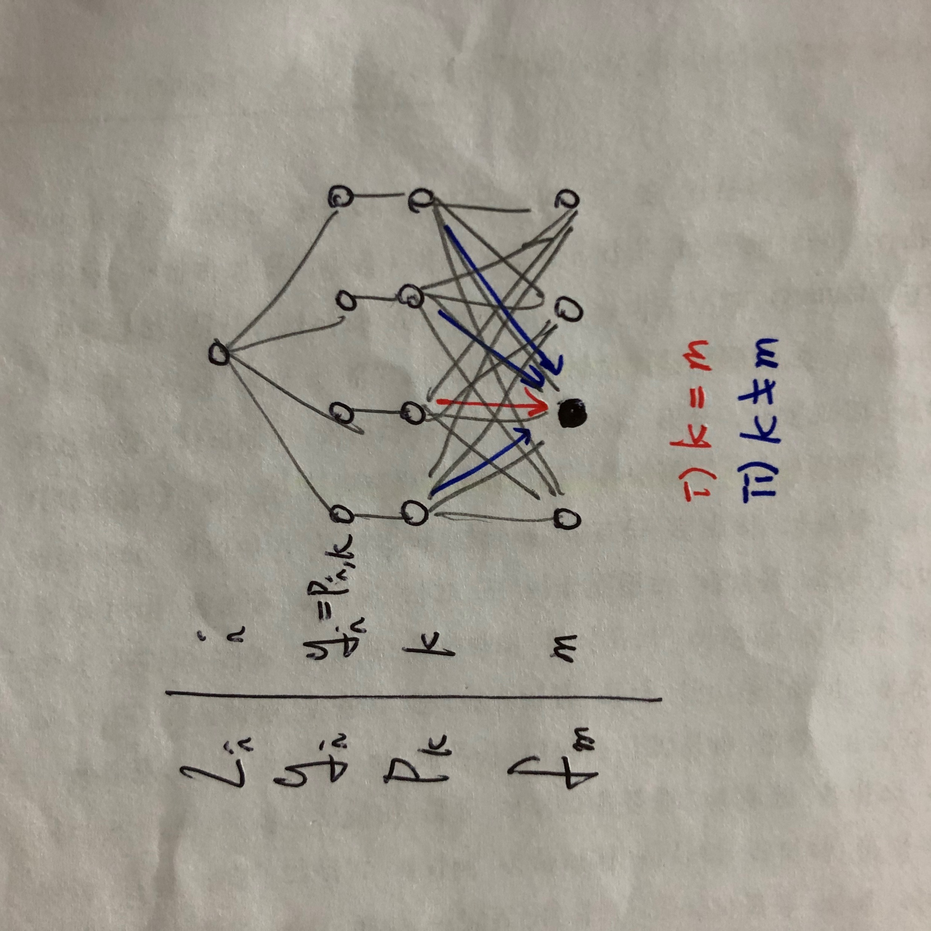
model.py
https://github.com/mnchl-kim/seq2seq-Numpy
seq2seq - Numpy
Stacked Recurrent Neural Networks
Output, $a^{<t>}$
< Backward Propagation >
ⅰ) Derivative of Softmax, Cross Entropy Loss
Prev
Hidden State
Next
Hidden State
$$a^{<t −1>}$$
$$a^{<t>}$$
Input, $x^{<t>}$
< t > cell
< Forward Propagation >
At last layer,
Multi-class Cross Entropy Loss

Slide 10
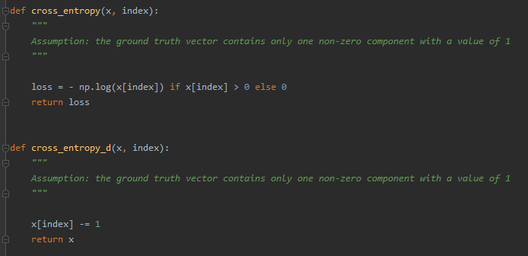
model.py
https://github.com/mnchl-kim/seq2seq-Numpy
seq2seq - Numpy
Forward Propagation

Slide 11
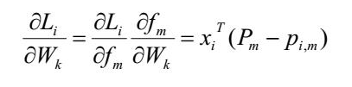
model.py
https://github.com/mnchl-kim/seq2seq-Numpy
seq2seq - Numpy
Stacked Recurrent Neural Networks
Output, $a^{<t>}$
< Backward Propagation >
ⅰ) Derivative of Softmax, Cross Entropy Loss
Prev
Hidden State
Next
Hidden State
$$a^{<t −1>}$$
$$a^{<t>}$$
Input, $x^{<t>}$
< t > cell
< Forward Propagation >
At last layer,

Slide 12
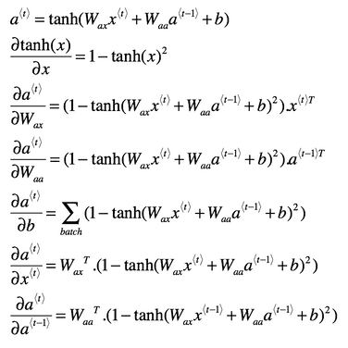
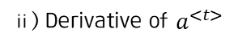
model.py
https://github.com/mnchl-kim/seq2seq-Numpy
seq2seq - Numpy
Stacked Recurrent Neural Networks
Output, $a^{<t>}$
< Backward Propagation >
ⅱ) Derivative of $a^{<t>}$
Prev
Hidden State
Next
Hidden State
$$a^{<t −1>}$$
$$a^{<t>}$$
Input, $x^{<t>}$
< t > cell
< Forward Propagation >
At last layer,

Slide 13
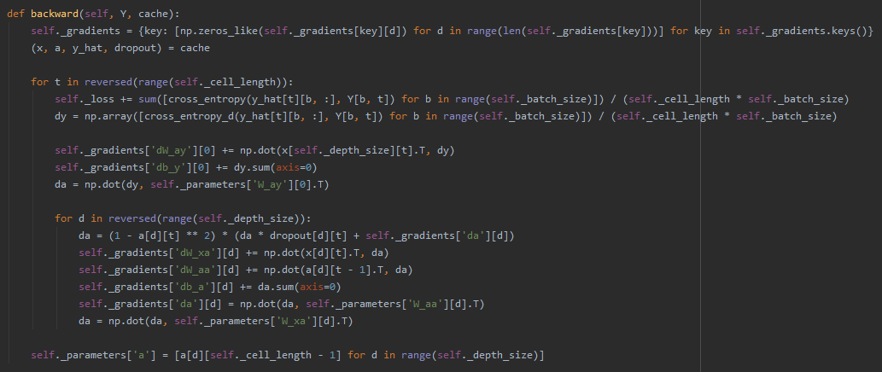
model.py
https://github.com/mnchl-kim/seq2seq-Numpy
seq2seq - Numpy
Backward Propagation

Slide 14
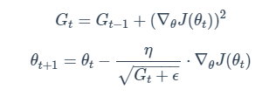
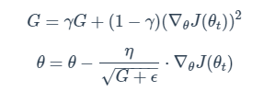
model.py
https://github.com/mnchl-kim/seq2seq-Numpy
seq2seq - Numpy
Weight update
1. Adagrad (Adaptive Gradient)
2. RMSProp

Slide 15
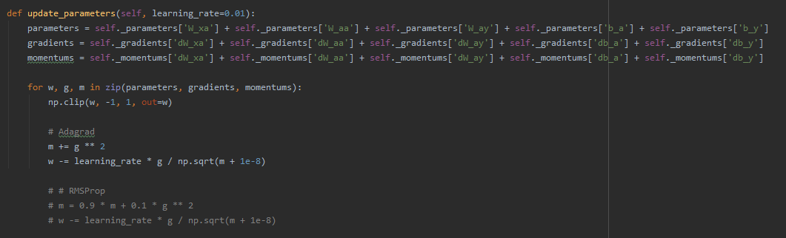
model.py
https://github.com/mnchl-kim/seq2seq-Numpy
seq2seq - Numpy
Weight update

Slide 16
train.py
https://github.com/mnchl-kim/seq2seq-Numpy
seq2seq - Numpy
Input Data
Text Data (The Little Prince.txt)
- Total characters : 93,609
- Unique characters : 81
> Character-level language generation
??
cell length
batch size
Total characters
mini_batch_X.shape : (b, t, x, 1)
mini_batch_Y.shape : (b, t, x, 1)

Slide 17
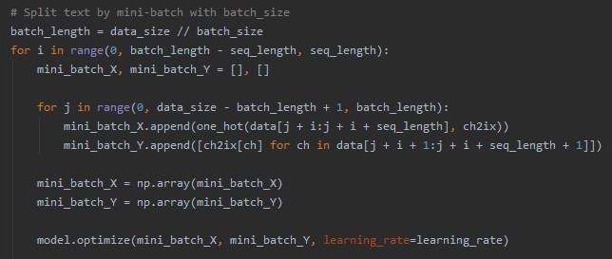
train.py
https://github.com/mnchl-kim/seq2seq-Numpy
seq2seq - Numpy
Input Data
mini_batch_X.shape : (b, t, x, 1)
mini_batch_Y.shape : (b, t, x, 1)

Slide 18
train.py
https://github.com/mnchl-kim/seq2seq-Numpy
seq2seq - Numpy
Training Process
Total iteration : 3,000
Input size : 81
Output size : 81
Hidden unit size : 256
Time length : 100
Depth size : 3
Batch size : 10
Dropout rate : 0.1
Learning rate : 0.01
Optimizer : Adagrad

Slide 19
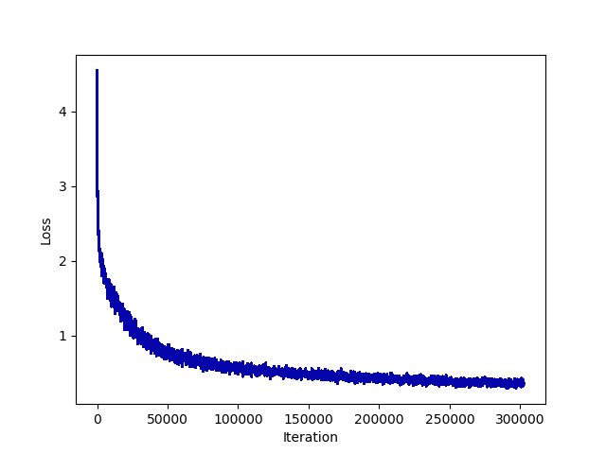
train.py
https://github.com/mnchl-kim/seq2seq-Numpy
seq2seq - Numpy
Training Process

Slide 20
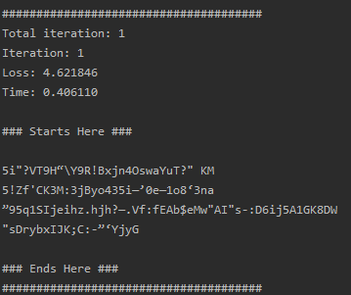
train.py
https://github.com/mnchl-kim/seq2seq-Numpy
seq2seq - Numpy
Training Process

Slide 21
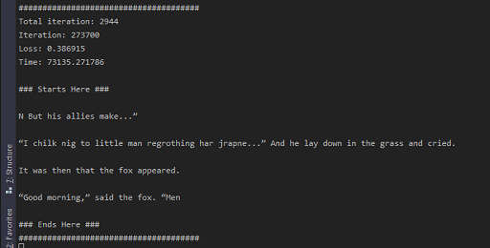
train.py
https://github.com/mnchl-kim/seq2seq-Numpy
seq2seq - Numpy
Training Process

Slide 22
Discussion
https://github.com/mnchl-kim/seq2seq-Numpy
seq2seq - Numpy
It can be used for sequence generation.
Language Generation
Medical Signal Generation (Ex, ECG)
Time-series prediction
Further Improvements
Running Time
Word Embedding
LSTM, GRU
Bidirectional RNN
Attention
Bert

Slide 23
Q&A?
SungKyunKwan Univ.
Samsung Advanced Institute for
Health Sciences & Technology
Department of Digital Health
Mincheol Kim
BMI Lab.

